Slide 1


CSA1104-Object Oriented Analysis and Design
SIMATS ENGINEERING
SAVEETHA INSTITUTE OF MEDICAL AND TECHNICAL SCIENCES
Technical Presentation
Online Banking System
Guided By Dr. A. Gayathri
Presented by:
N. Hima Harshitha (192371063)

Slide 2
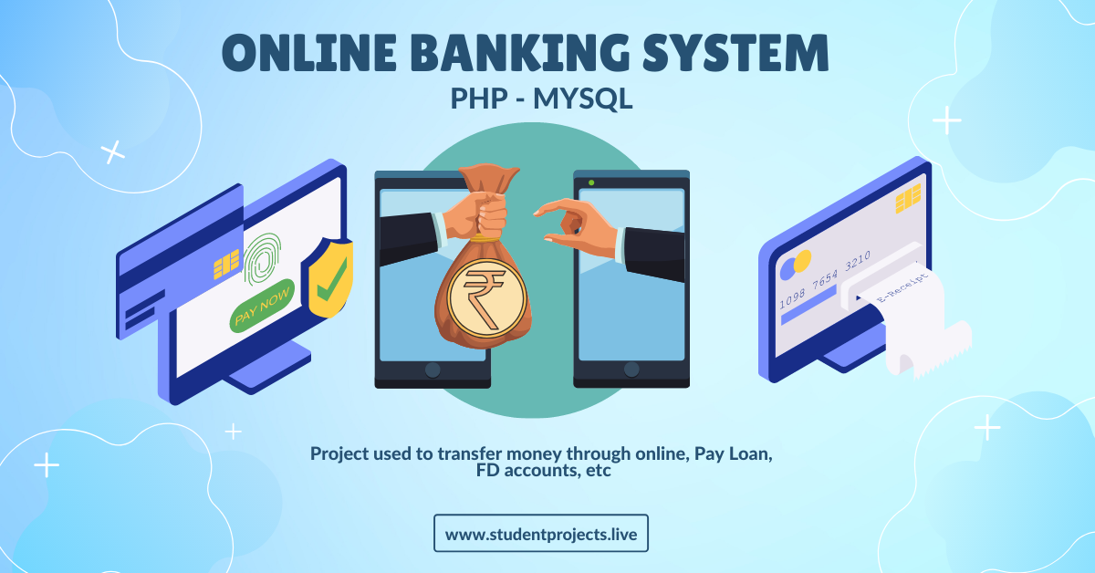
INTRODUCTION
What is Online Banking?
Online Banking is a digital service that allows customers to access banking services through the internet.
It enables banking anytime and anywhere.
It provides secure and convenient financial transactions.

Slide 3
OBJECTIVES
Objectives of Online Banking System
To provide secure and convenient banking services over the internet.
To allow customers to access their accounts 24×7.
To reduce paperwork and manual banking operations.
To improve transaction speed and banking efficiency.
To enhance customer satisfaction through digital services.

Slide 4
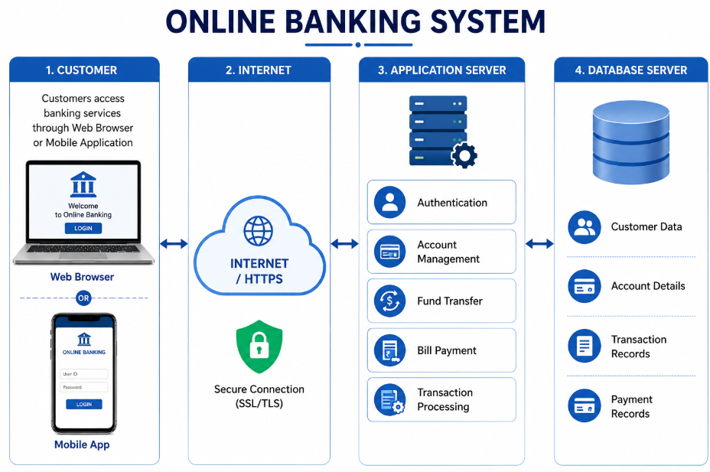
SYSTEM ARCHITECTURE

Slide 5
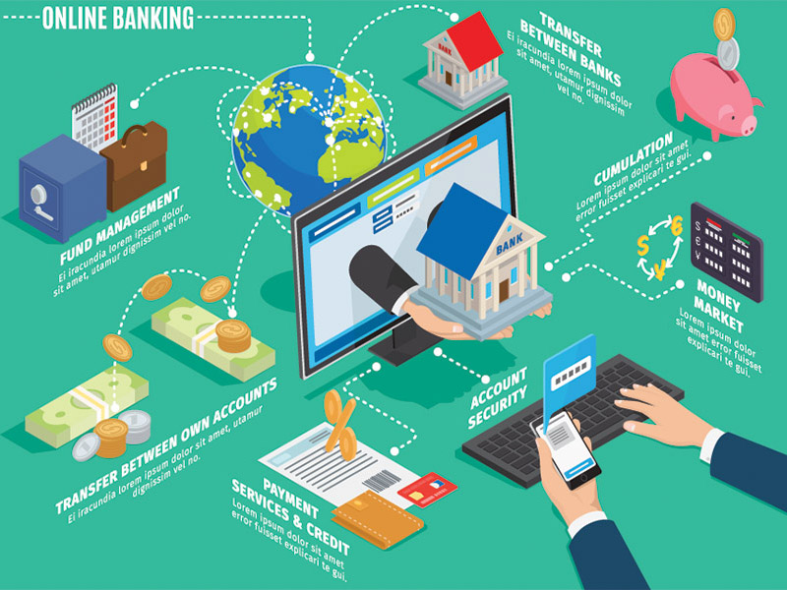
ADVANTAGES
Benefits of Online Banking
Provides banking services anytime and anywhere.
Saves time by reducing branch visits.
Enables fast and secure money transfers.
Reduces paperwork and operational costs.
Improves customer convenience and satisfaction.
Supports digital and cashless transactions.

Slide 6
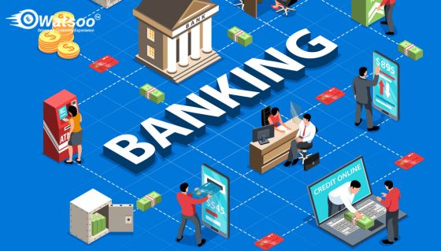
CHALLENGES
Limitations and Challenges
Requires a stable internet connection.
Vulnerable to phishing and cyber attacks.
Users must protect their login credentials.
Technical issues may temporarily affect banking services.
Some users may find digital banking difficult to use.

Slide 7
CONCLUSION
Online Banking has transformed traditional banking into a faster and more efficient digital service.
It offers secure, reliable, and convenient banking without visiting a physical branch.
Advanced security technologies help protect customer data and financial transactions.
Future innovations such as AI and blockchain will make online banking even more secure and user-friendly.

Slide 8


